Slide 1



Practice
Collecting Review Data
Digital Business Ecosystem Research Center

Slide 2
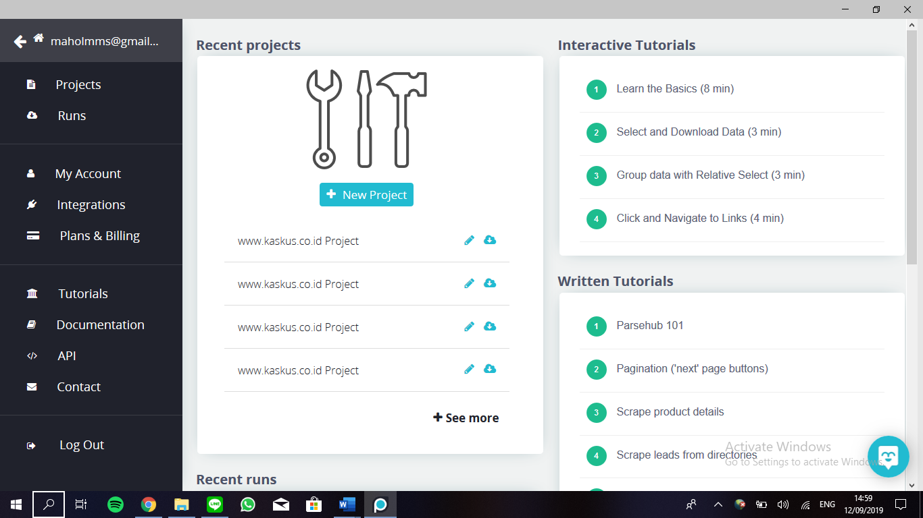
In the main page, click new project to start

Slide 3
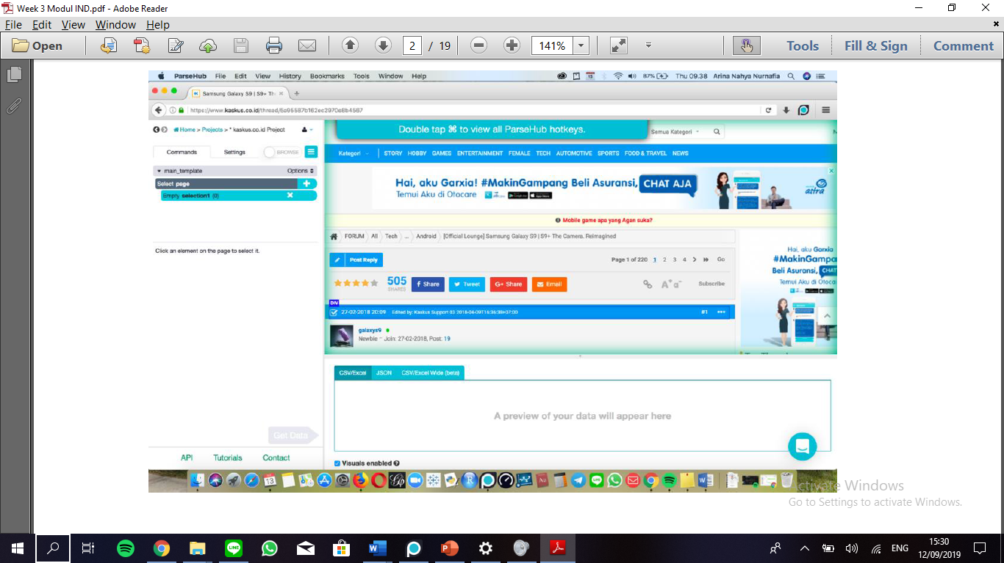
Place the link, today we use Samsung S9 thread.
Can be accessed through
https://www.kaskus.co.id/thread/5a95587b162ec2970e8b4567

Slide 4
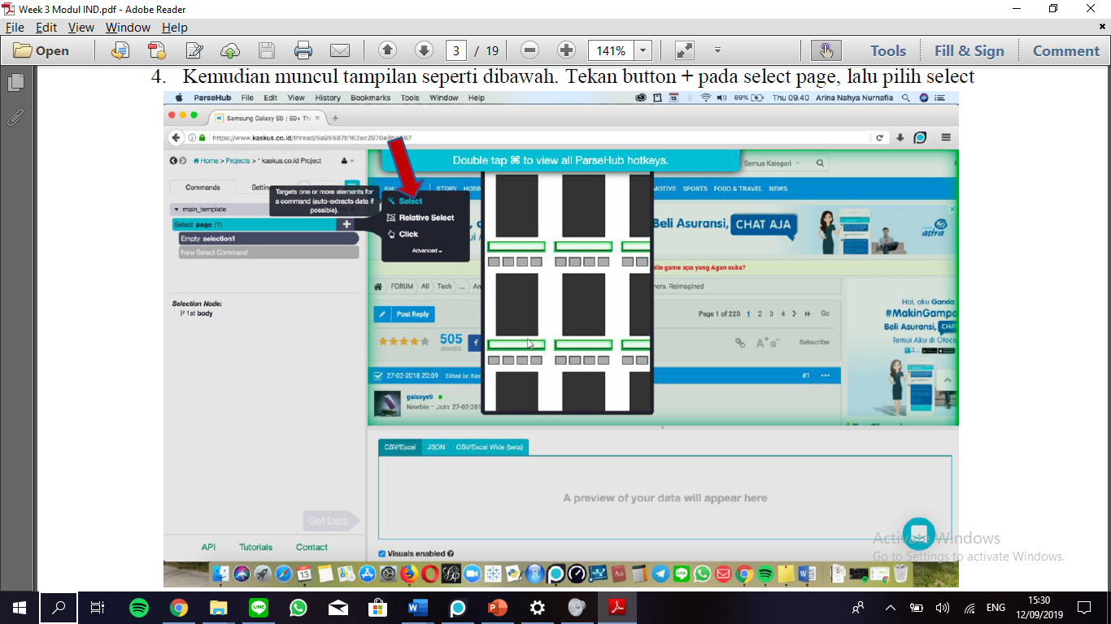
Click at the plus button, then click select.

Slide 5
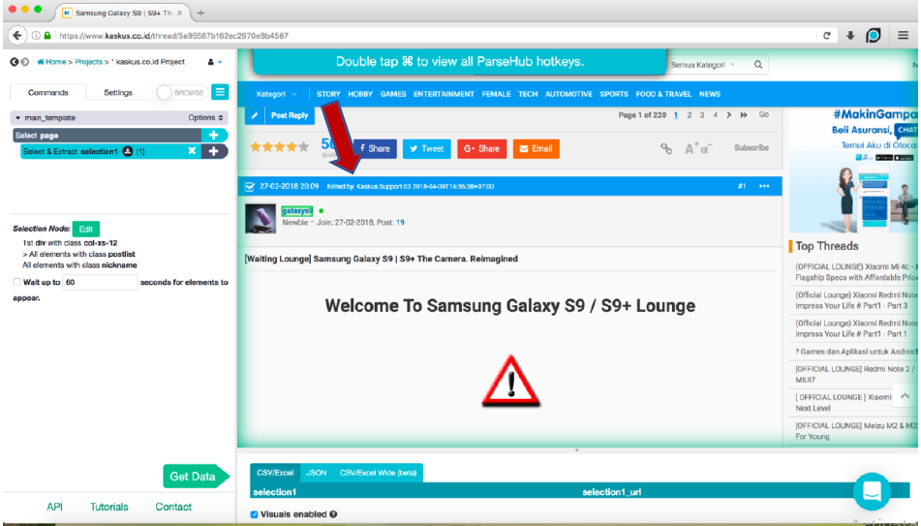
Click the first username, the color will be changed to green.
Scroll down and click at the other username.

Slide 6
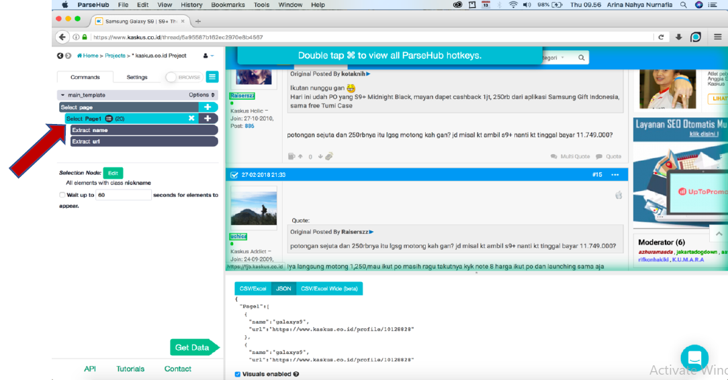
Change the commands name to “Page1”

Slide 7
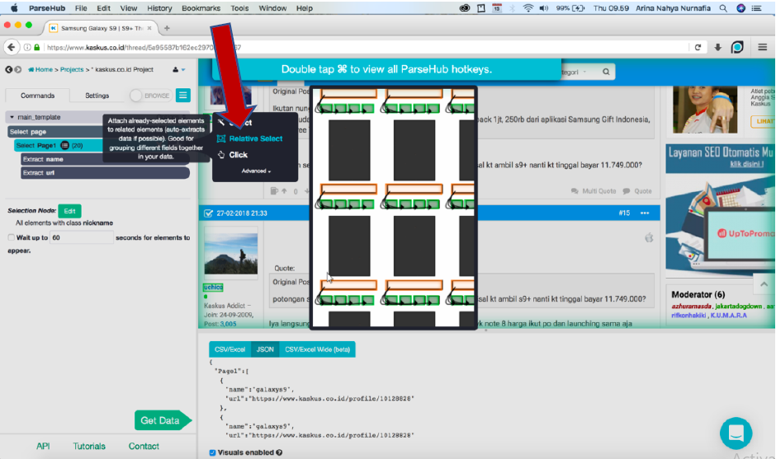
Click the plus button and choose relative select.

Slide 8
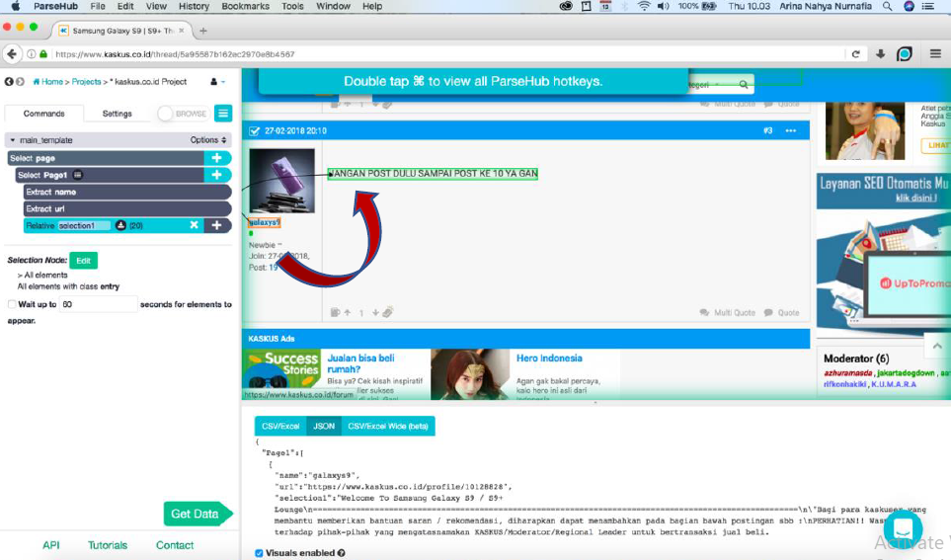
To relate username to the user comment, click username and place the arrow to the comment area.

Slide 9
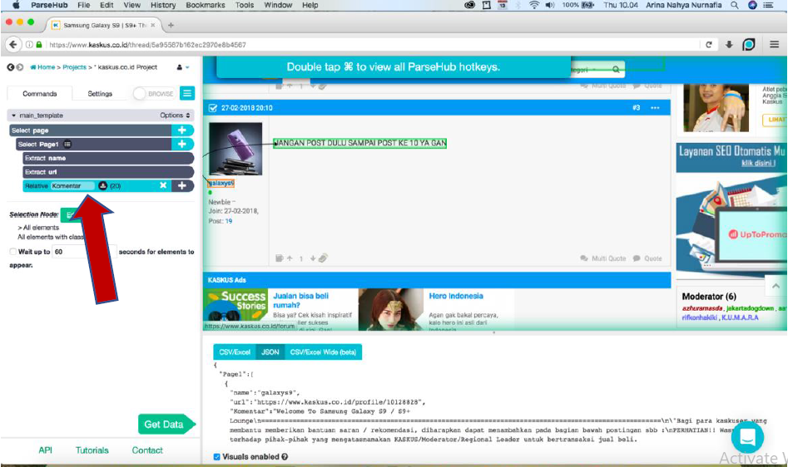
Change the name to “comment”

Slide 10
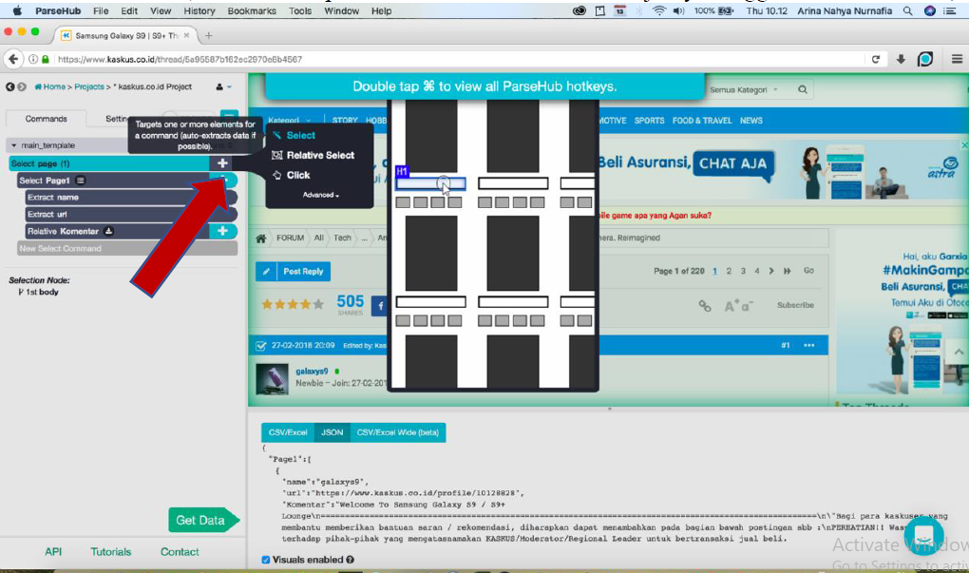
To crawl until the last page, we use pagination.
Click the plus button, and choose select

Slide 11
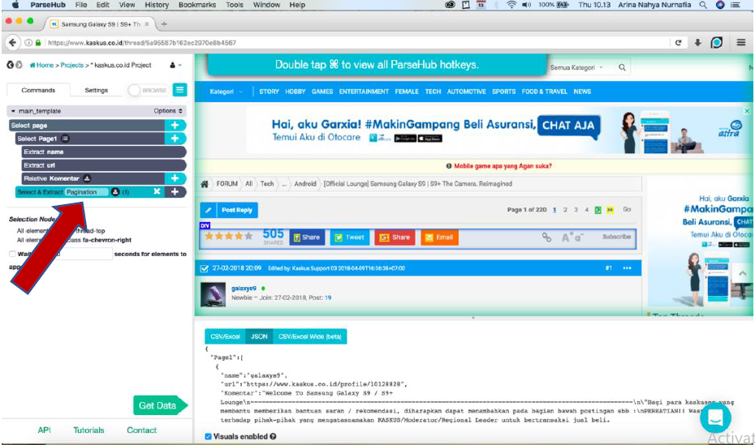
Change the name to “pagination”

Slide 12
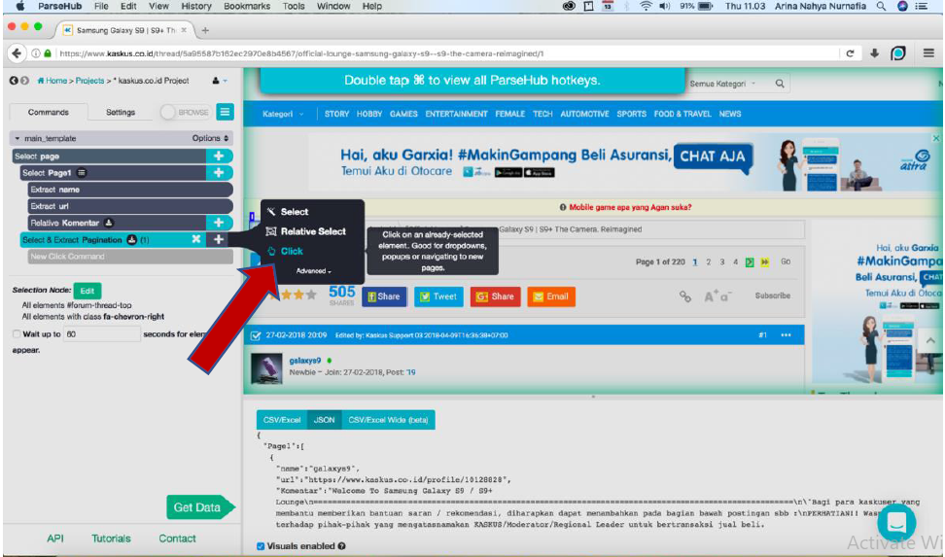
Click the plus button and choose

Slide 13
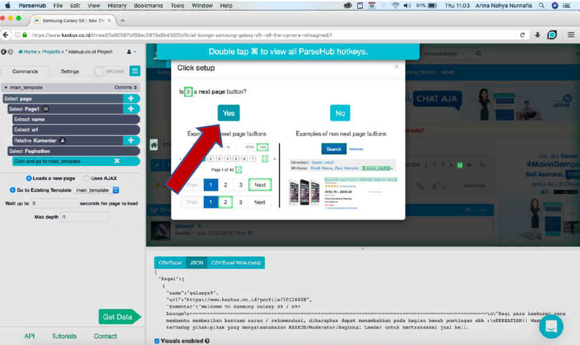
Click the “Yes” button

Slide 14
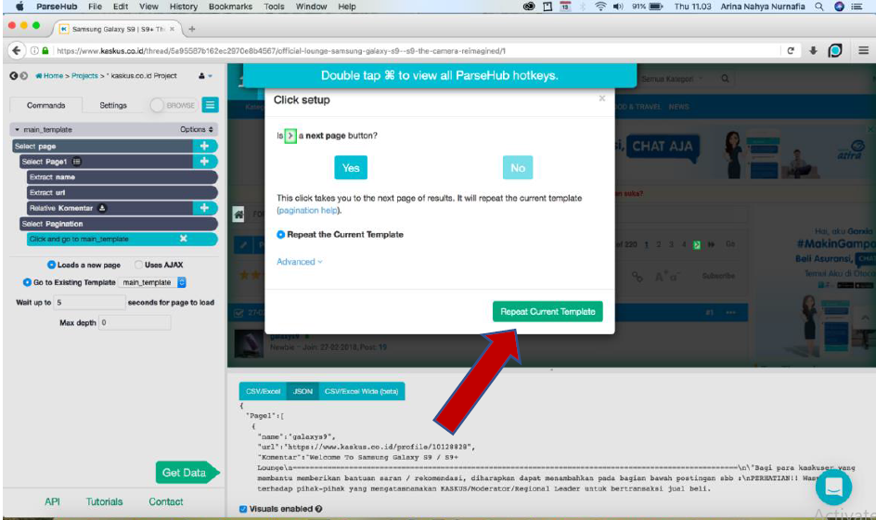
Click “Repeat Current Template” button to make sure that we use the same template for each page.

Slide 15
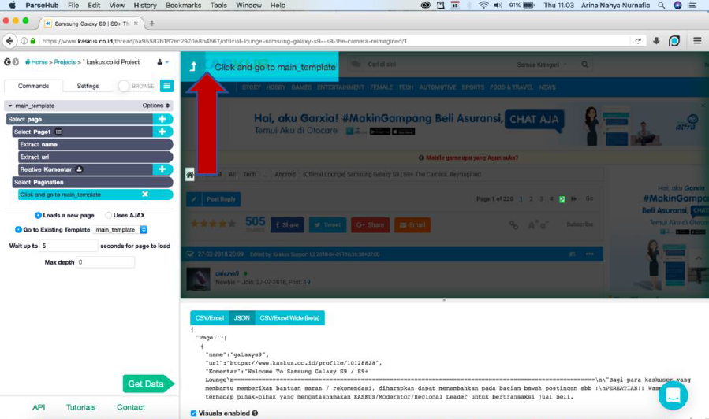
Click the “click and go to main_template” button

Slide 16
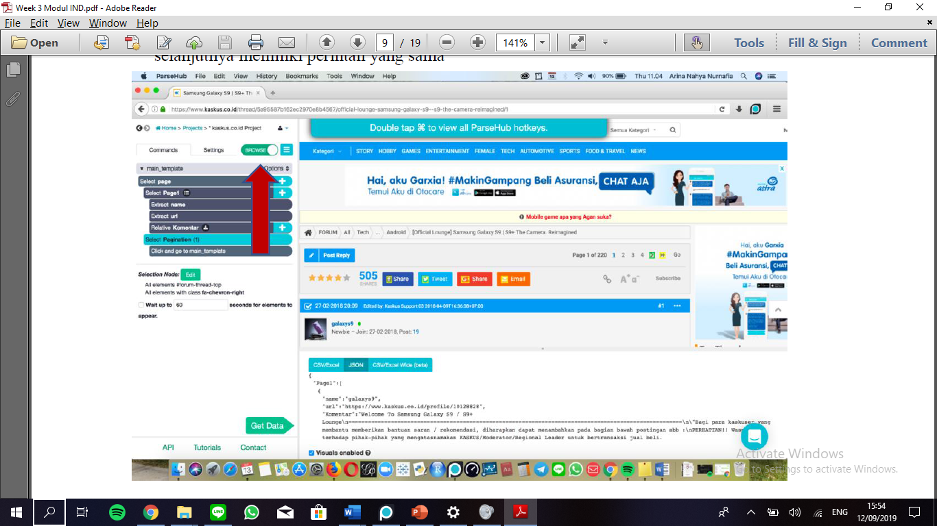
Change the page to browse mode and make sure that each page already use the same template. Then turn off the browse mode.

Slide 17
Click the “get data” button and click “run” to start the crawl process

Slide 18
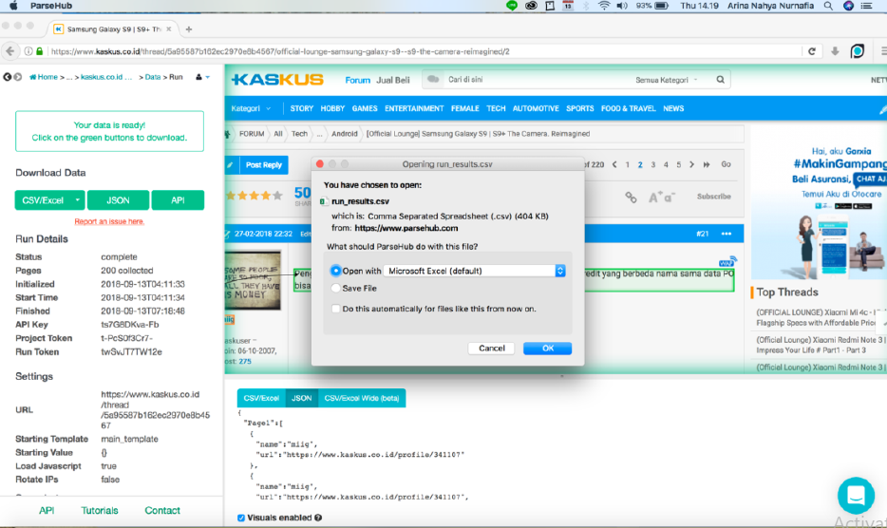
If all of the data needed is collected, then click the “download” button

Slide 19
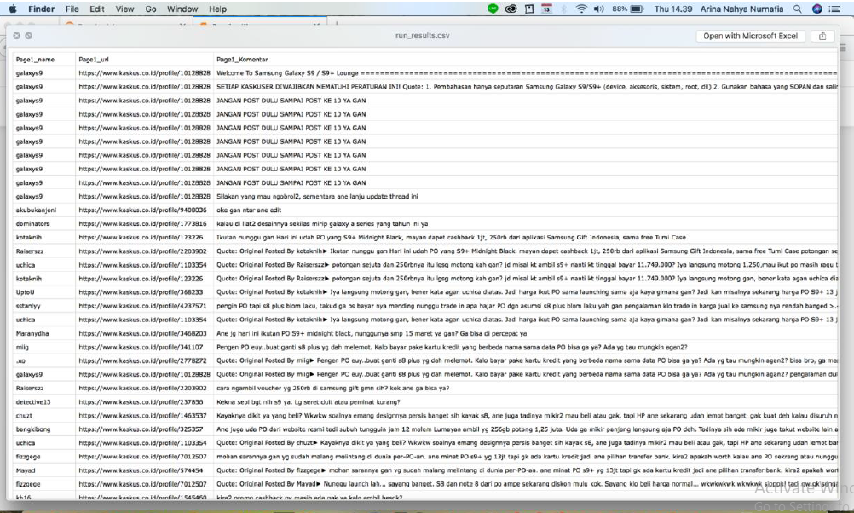
Saved in CSV format.

Slide 20

THANK YOU

